Slide 1
Information Gatheing

Slide 2
Reconnaissance or Open Source Intelligence (OSINT) gathering
OSINT gathering is an important first step in penetration testing.
Gathering as much intelligence on your organization and the potential targets for exploit.
Clear understanding of the client’s systems and operations before you begin exploiting.
(how a target works and its potential vulnerabilities.)

Slide 3
Information Gathering
E.g. Gathering is like breaking into a house.
There’s no need to break down the door to get inside when there is a window open.
if the company we are testing has left any doors unlocked or maybe a window open.

Slide 4
Common reconnaissance include
Search engine queries
Domain name searches/WHOIS lookups
Social Engineering
Internet Footprinting
Internal Footprinting
Dumpster Diving
Tailgating
Reconnaissance
email addresses, usernames, social networks,
Ping sweeps, port scanning, reverse DNS, packet sniffing
personnel, systems, or technologies
Get subdomains, people’s names
positions, technologies, email addresses
Get physical access or pictures

Slide 5
TYPES OF INFORMATION GATHERING
1. WEB BASED INFORMATION
2. NETWORK BASED INFORMATION GATHERING
3. INDIVIDUAL INFORMATION GATHERING

Slide 6

1. WEB BASED INFORMATION GATHERING :
identify the services, website and its owner related details.
services of the Website it is using,
what are the directories a Web Application is having,
Server type whether it is using a Shared Server or a Dedicated Server etc.
Some Useful Tools -
https://whois.icann.org/en ,
https://whois.domaintools.com/,
https://mxtoolbox.com/

Slide 7
To understand
If some says website is hacked, website is not hacked.
Webserver is hacked.
Website is a folder called web directories
If you access of one folder (website) technically you have entered into the server.
Web Server (10.112.116.114)
Website 1
Website 2
Website 3

Slide 8
Webservers
2 types of Web Servers
Shared Webservers
Dedicated Webservers

Slide 9
Shared Web servers
Many websites with multiple owners on same servers
Allows multiple websites to utilize a single server.
the most economical option for hosting,
Overall cost of server maintenance is amortized over many customers.
Disadvantages
Higher risk of attack
Bad neighbours on a shared server can get the entire IP address blacklisted
Unexpected bursts of web traffic could drain the server’s limited bandwidth resources.
This leads to slow response time and slow loading time

Slide 10
Dedicated Web servers
Website is the only site hosted on the server.
own dedicated server is the ultimate “fence”.
Extremely unlikely to get blacklisted
Website is the only user, there are fewer chances to acquire
High cost 30000-35000
Unless organization engages in unethical or illegal internet practices.
viruses,
malware and
spyware
Because of poor neighbours and misconfigured security.
Disadvantage

Slide 11
Reconnaissance Tools
dnsstuff.com- https://www.dnsstuff.com/
Netcraft.com- https://toolbar.netcraft.com/site_report
Yougetsignal.com- https://www.yougetsignal.com/
Whois.icann.org - https://lookup.icann.org/, ttps://whois.icann.org/en/about-whois
whois.domaintools.com- https://whois.domaintools.com
Mxtoolbox.com- https://Mxtoolbox.com
Ip2location.com- https://Ip2location.com
Ip-tracker.com- https://Ip-tracker.com
Wappalyzer.com- add as extension/ plugin
etc

Slide 12
Tool 1

Slide 13
Dnsstuff.com
It has lot of tools which provide information https://tools.dnsstuff.com/
Domain tools
Whois lookup
DNS lookup
SSL examination- domain is using SSL or not
IP tools
Reverse DNS- country tool – IP ranges for country
DNS Root Server Response Time
Networking tools
DNS Traversal
DNS Timing
Email tools
Email Test
Spam blacklist lookup
Email path analyser
Generates report

Slide 14
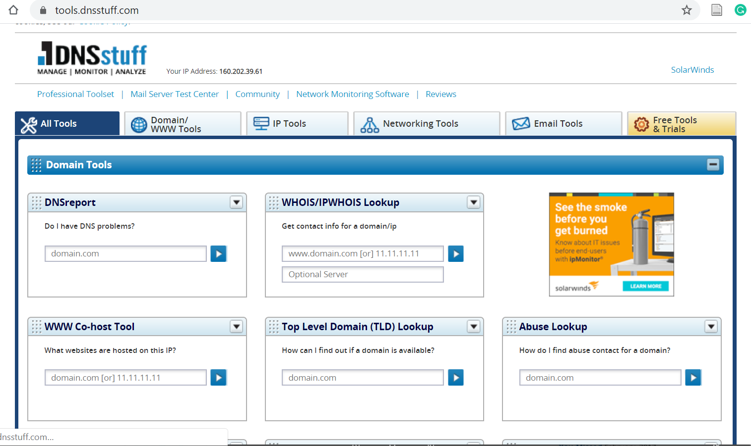
Dnsstuff.com

Slide 15
Dnsstuff.com- DNSReport
DNSreport
It generates report
It gives details of parent zone DNS servers
Records open DNS server
Generate Report & analyse- 5 mins Task

Slide 16
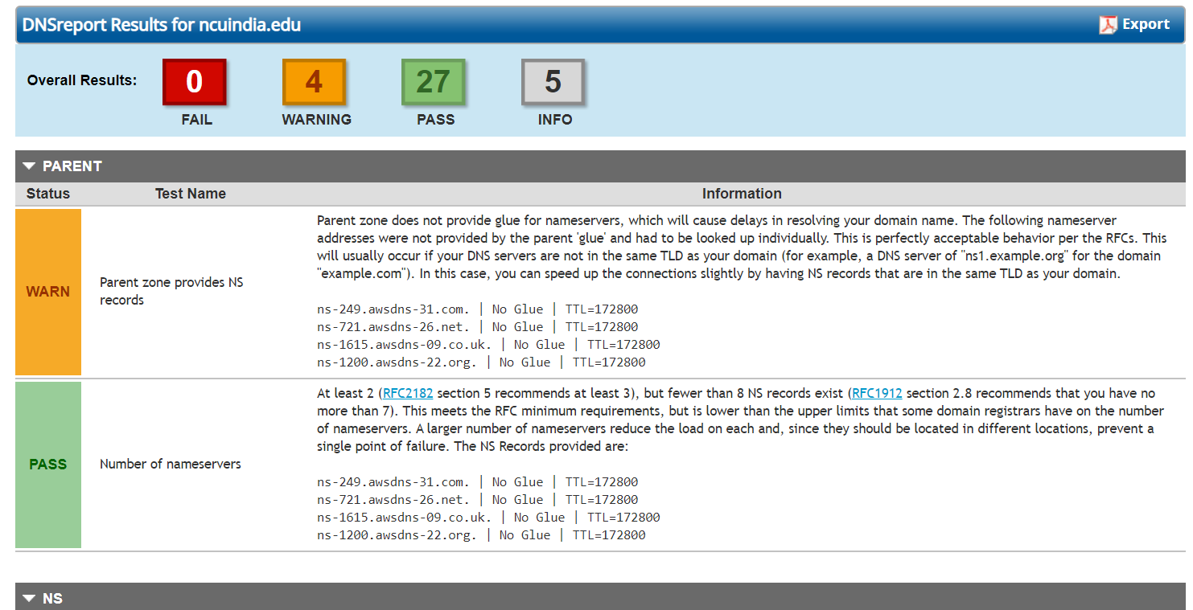
Dnsstuff.com- DNSReport

Slide 17
Dnsstuff.com-Whois Lookup
Whois Lookup
Generate information regarding domain
Date of domain created
Domain Updation date
Source of the information is collected
Contact details (No privacy- open source)- this is valuable information
Server information
Etc.

Slide 18
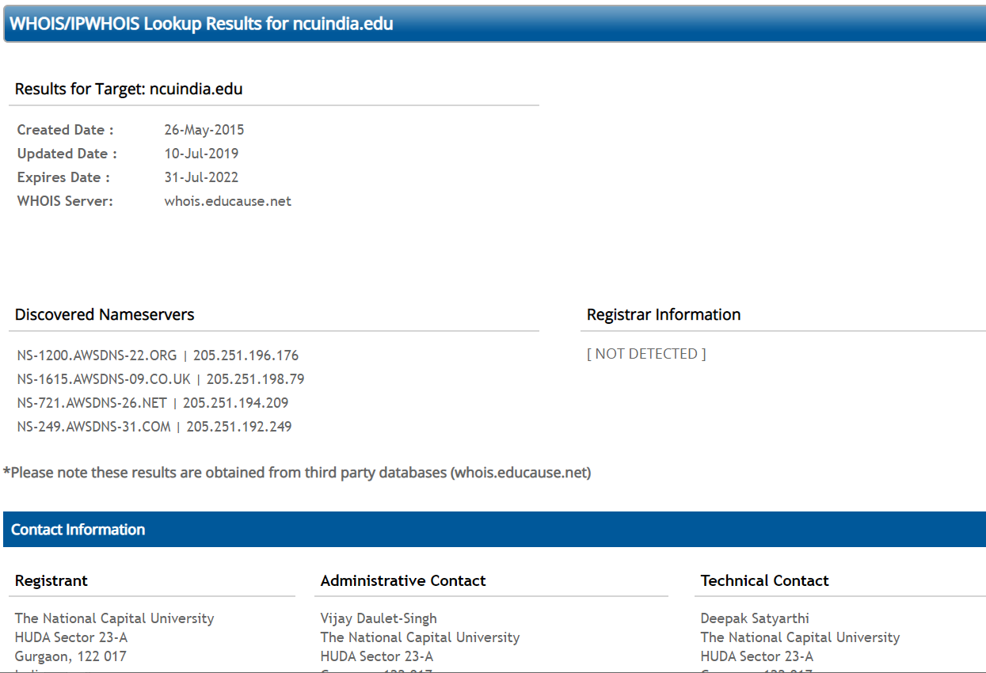
Dnsstuff.com-Whois Lookup
Can be searched in who.is

Slide 19
Tool 2

Slide 20
Netcraft
Allows to understand what is running behind the website
What is IP address on website server it is hosted on
Web tracker
Server side technology
What are the frameworks
CMS system
Domain registrar
DNS administrator
Email

Slide 21
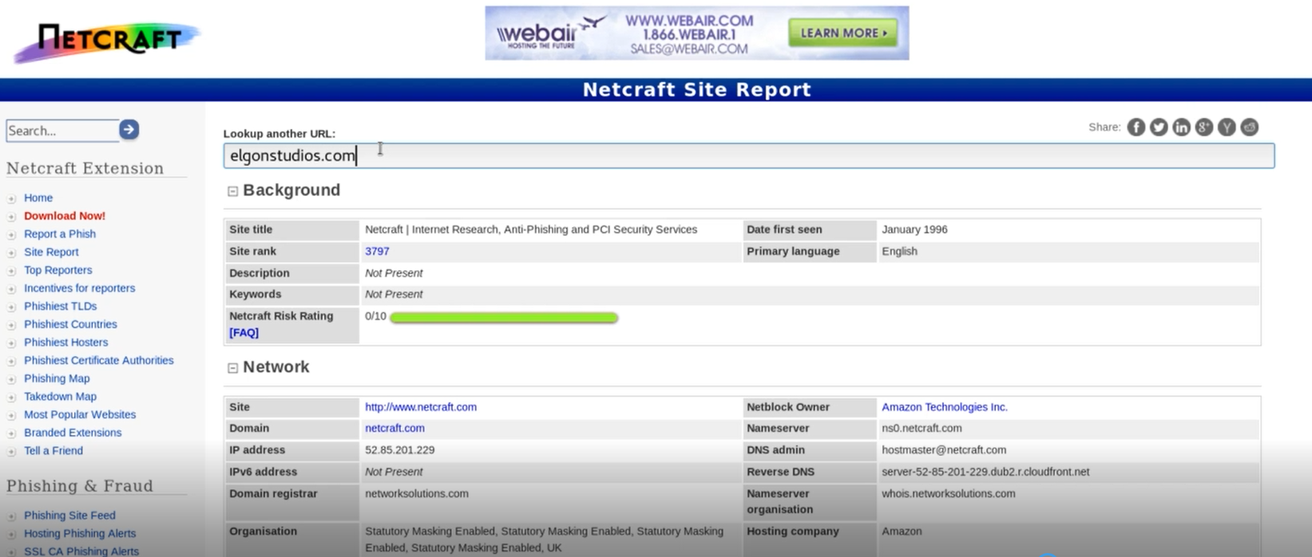
Netcraft: https://www.netcraft.com/

Slide 22
Tool 3

Slide 23
Whois Lookup
You asking database whois to search
Who is this domain registered to?
More details of the domain etc.
Can use this tool on Kali Linux
Command:
Whois hspolit.com

Slide 24
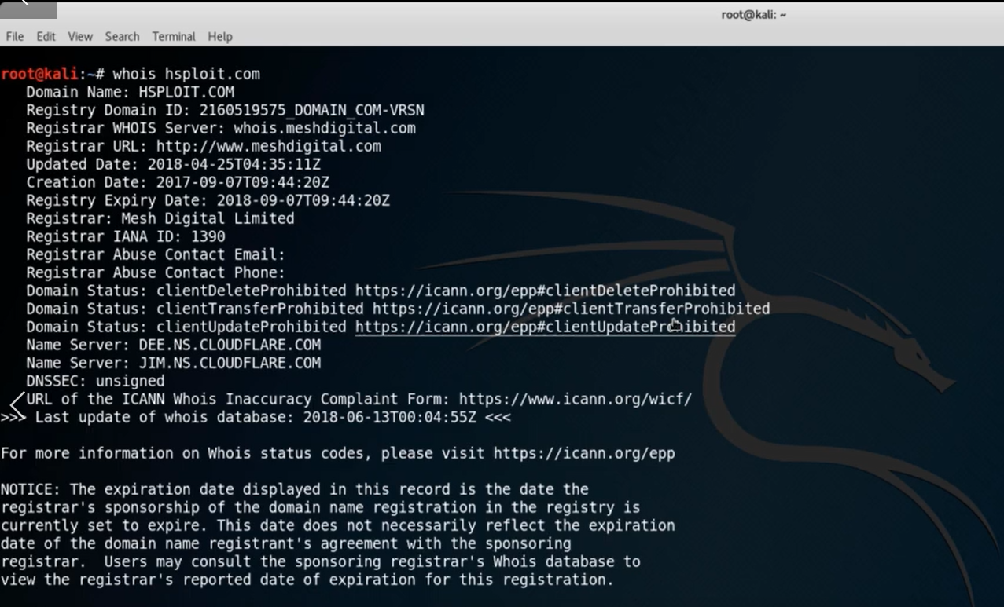
Whois

Slide 25
Whois Lookup
Whois hspolit.com
Domain was brought
Update date
Contact emails
Name servers-important
What type of system is running behind the system
Is there is firewall

Slide 26
Whois task- 5 mins (kali Linux)
Whois ncuindia.com
What all information is visible?
Is your website secure?

Slide 27
Tool 4

Slide 28
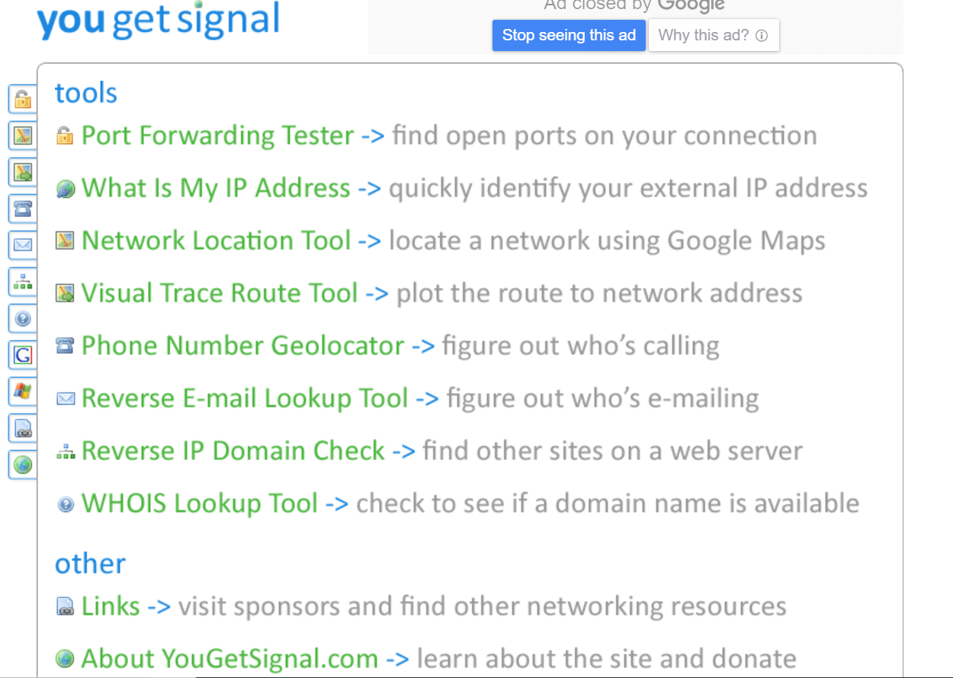
Yougetsignal.com (Tool)
Check many things online
Shared/Dedicated webserver
IP address
Traceroute
Whois lookup
Reverse IP domain
etc

Slide 29
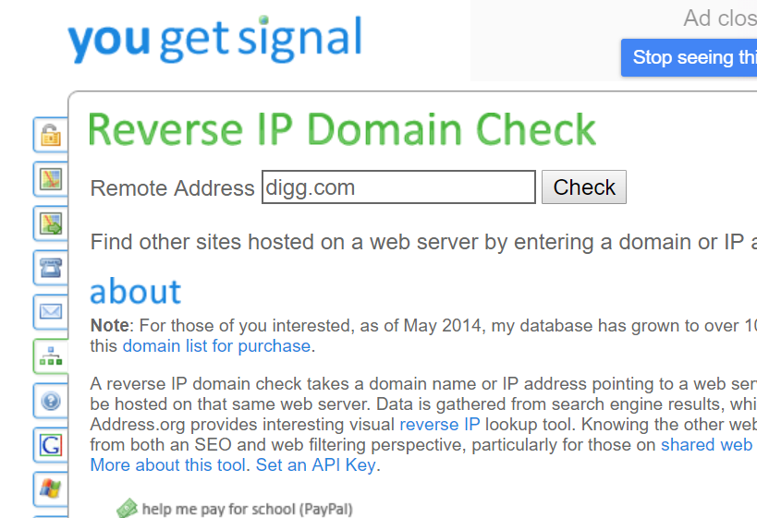
Yougetsignal.com (Tool) ->Reverse IP domain
Check number of domains and IP address of web server

Slide 30
Yougetsignal.com->Reverse IP domain
www.google.com, shows all the subdomains of google and shows it uses dedicated web sever.
www.soch.com it shows 1000 domains hosted on same web server. Therefore it is shared web server
All websites hosted on same web server have same IP address
Search www.ncuindia.edu only one domain (dedicated)

Slide 31
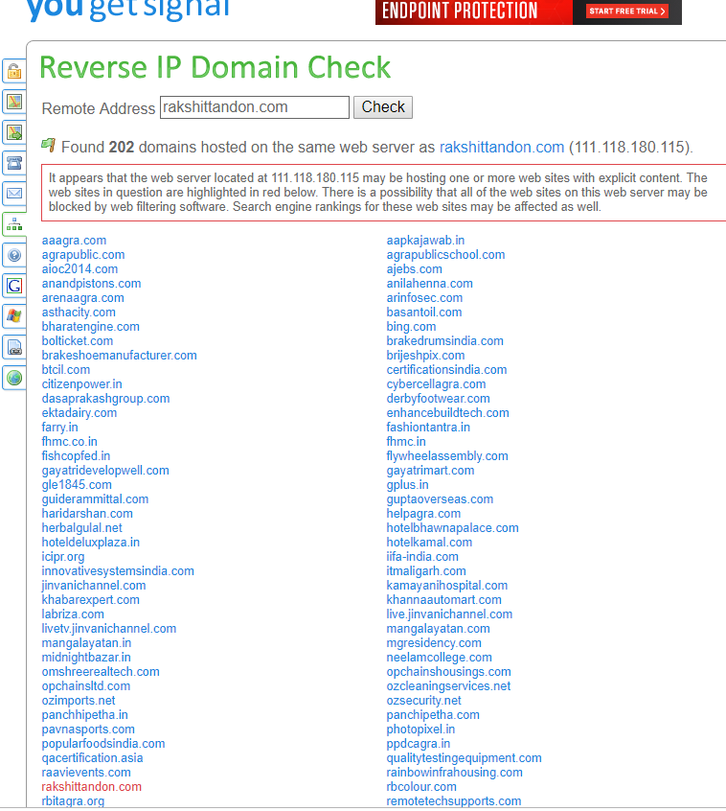
Case study
Rakshit Tandon
Website was hacked as it was on shared web server where one website was panchipetha.com(hacked).
Check on yougetsignal.com
Red colored (reported for spam by someone)

Slide 32
Tool 5

Slide 33
whois.icann.org (search on google)
ICANN (father) Non-profitable org
IANA (Son)-paid
Service Provider (Godaddy.com)
Domain is provided by
Whois.icann.org

Slide 34
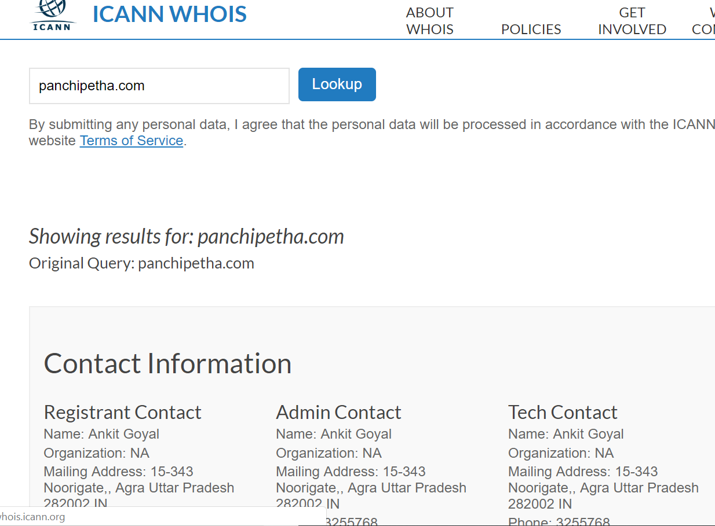
Whois.icann.org
Can see the details of website
E.g. panchipetha.com

Slide 35
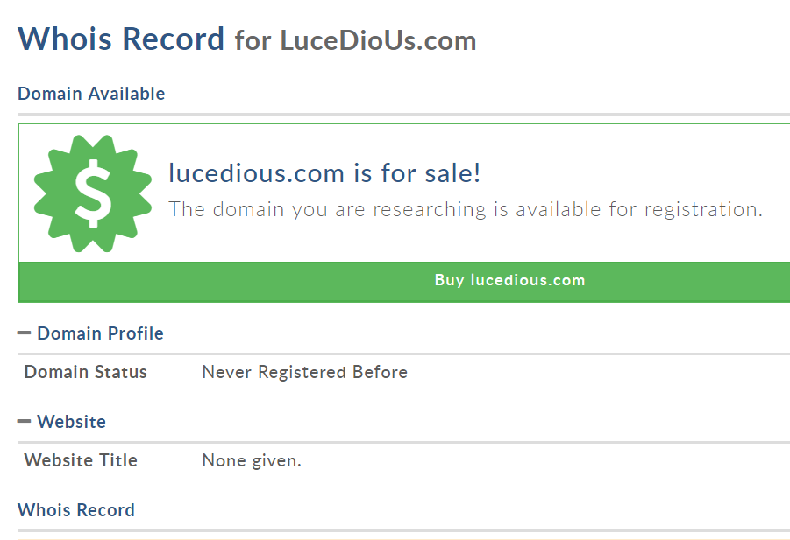
Whois.icann.org
Can see the details of website
E.g. Lucideus.com
No information is revealed

Slide 36
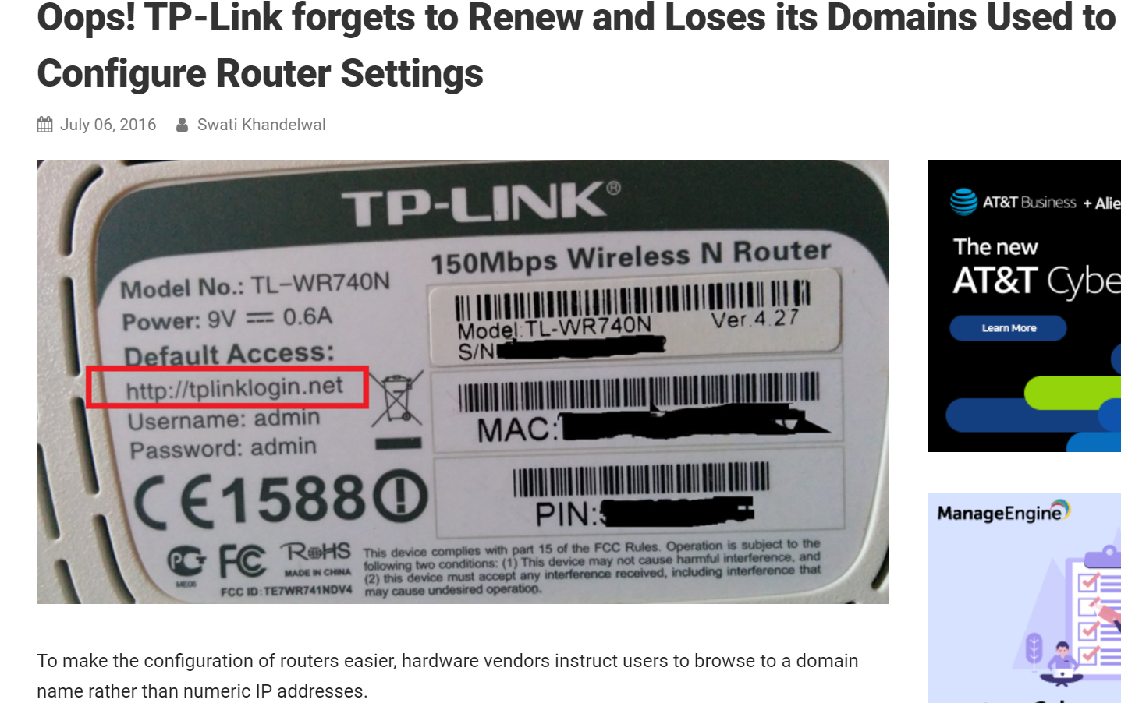
Case study-search
TP link forgets to renew the domain, then some other person bought that link… loss to TP link
TP-Link bought same domain from that person 2.5$million

Slide 37
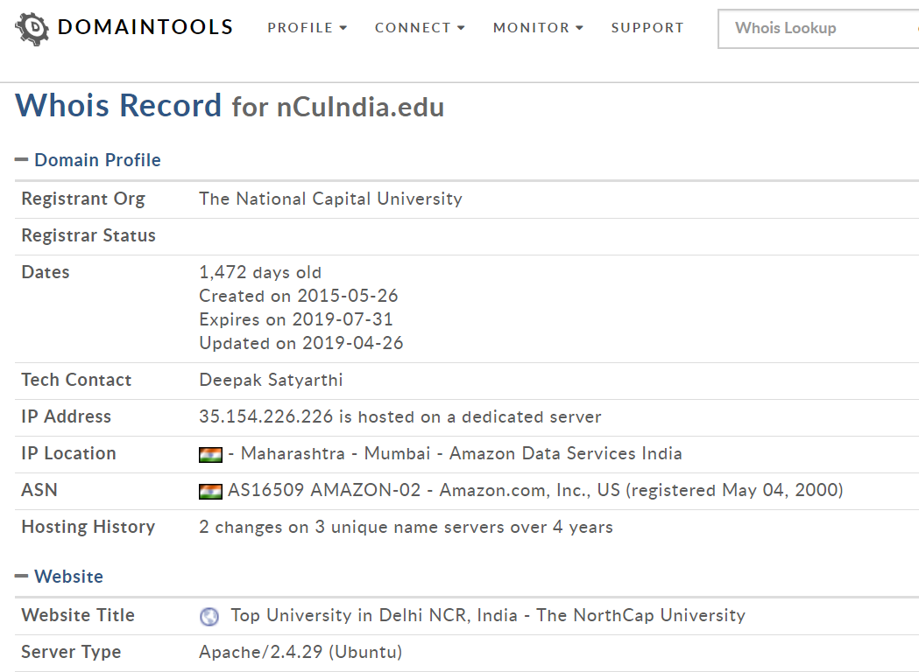
whois.domaintools.com
Network
domains and IPs,
connects them with nearly every active domain on the internet.
IP Location
Hosting History
These connections help security professionals profile attackers, guide online fraud investigations, and map cyber activity to attacker infrastructure.

Slide 38
Tool 6,7,8,9

Slide 39
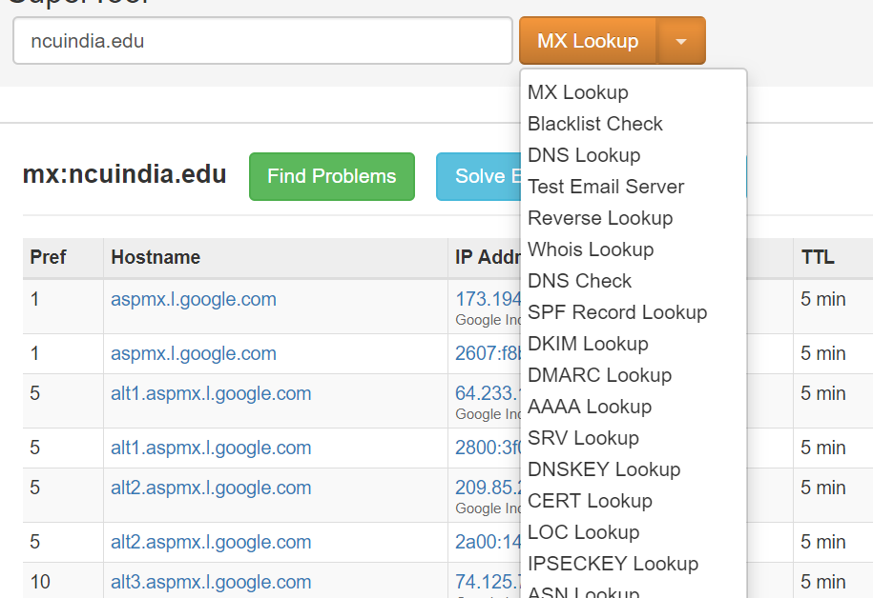
Mxtoolbox.com
Lots of information can be revealed through this tool
It has drop down menu
What ever information is required can be seen from drop down

Slide 40
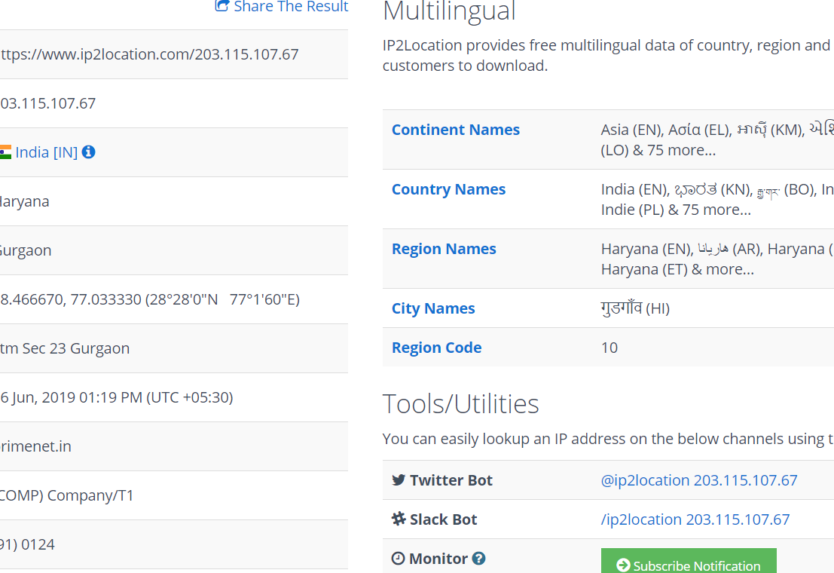
Ip2location.com
It takes the IP address and tells the coordinates of city, domain, city, region, Area code etc

Slide 41
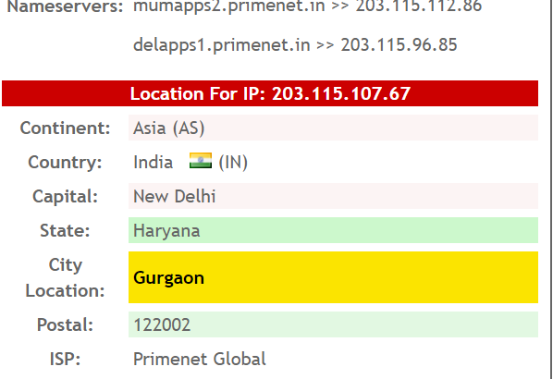
Ip-tracker.com
Tool with power and accuracy that gives you easy way to lookup, find, track and trace any IP in the world.
Traces Internet Protocol Address and information about IP location and other related information to your IP

Slide 42
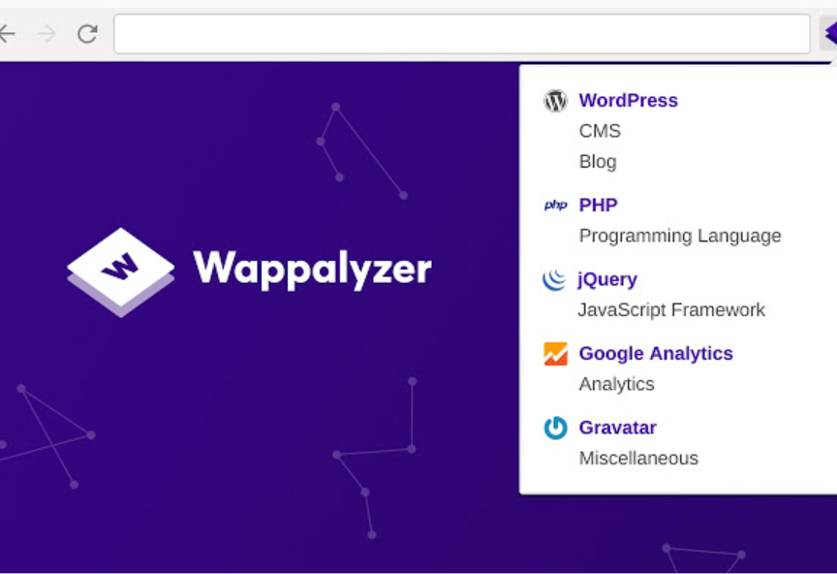
Wappalyzer.com
Download the tool, Install with firefox (add as plugin).
Technologies Identified:
Frontend
Backend
Wappalyzer is a cross-platform utility that uncovers the technologies used on websites. It detects content management systems, ecommerce platforms, web frameworks, server software, analytics tools and many more.
It tells info related to wordpress, cms, PHP

Slide 43
DRILL
Select
Select one Website
Use
Use the above tools to find all the relevant information of selected website
Prepare
Prepare a report

